Slide 1

Making Sense (Cents?): Having a Disability-Friendly Business
Why it Pays to Make Your Business Accessible for
People with Disabilities

Slide 2

Why It Pays . . .
Customers with Disabilities, by the Numbers
There are 56.7 million people with disabilities in the United States (2010 US Census).
People with disabilities make up the largest minority group in the country (2012 SIPP).
20.9 million families have at least one member with a disability.
Millions of people with disabilities regularly travel, shop, and dine out with family and friends.

Slide 3
Discretionary Spending of People with Disabilities
The market of people with disabilities has over $200 billion in discretionary spending, four times the spending power of teenagers (U.S. Dept. of Labor).
Diners with disabilities are estimated to spend $35 billion annually in restaurants (www.pnnonline.org).
Spending by travelers with disabilities exceeds $13.6 billion annually (NY Times).

Slide 4

25 Ways to Have a Disability-Friendly Business*
*Adapted from Kevin A. Fritz’ Article Titled “25 Easy Ways to Make Your
Business More Accessible to Customers with Disabilities.” Seyfarth Shaw
LLP, July 29, 2015

Slide 5

1. Main Entrance
If possible, make it accessible.
If not, post clear signage directing patrons to an alternative entrance that is accessible.
Use the International Symbol of Accessibility.
Provide parking near the accessible entry.
For more information about ADA accessibility standards for public accommodations and commercial facilities, please read the Americans with Disabilities Act Title III Technical Assistance Manual: https://www.ada.gov/taman3.html

Slide 6
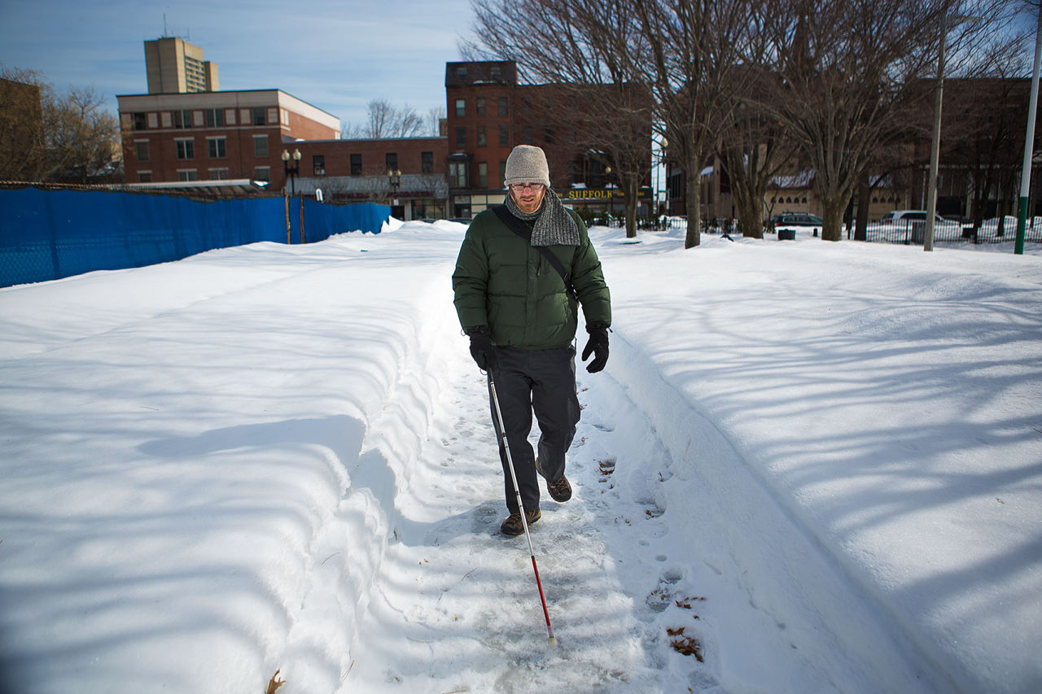
2. Outdoor Pathways
Keep clear and free from clutter and snow.
Trees, flowers, and bushes should be trimmed so as not to obstruct individuals with blindness and those who use wheelchairs.

Slide 7
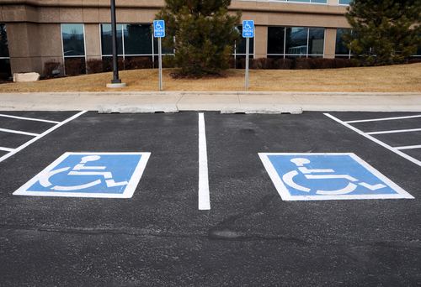
3. Parking
Provide accessible parking spaces as close to the accessible entrance as possible.
Ensure that spaces and access aisles include appropriate signage.
Find more information about accessible parking, in section 7.43 of the ADA Title 3 TA Manual: https://www.ada.gov/taman3.html

Slide 8
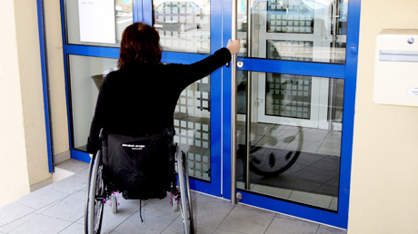
4. Doors
Adjust door closers so less force is needed to open them.
Heavy and hard-to-open doors can be difficult for anyone, including people with disabilities.

Slide 9
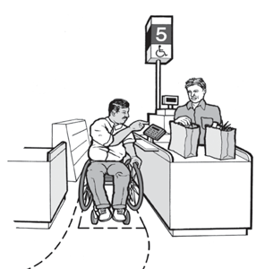
5. Indoor Pathways
Have an accessible register or checkout open and available whenever the place of business is open.
Keep aisles and clothes racks wide enough for a wheelchair to pass through.

Slide 10
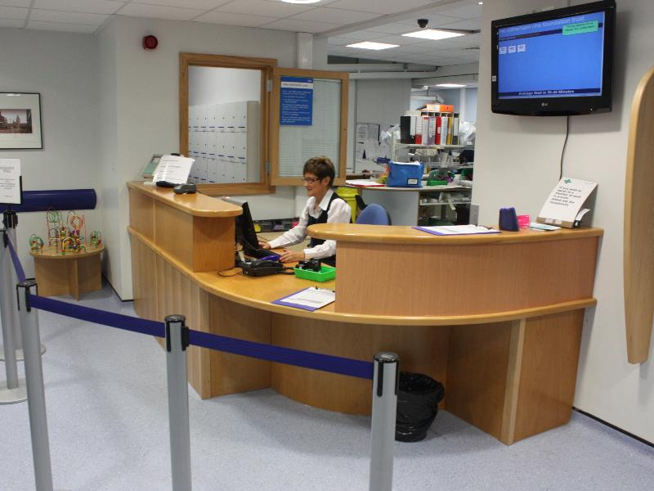
6. Counters
Provide a lowered counter at checkout and other integral places within your business.
Keep counters free of clutter.

Slide 11
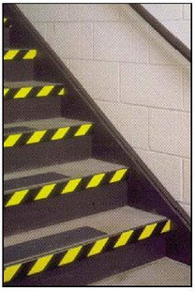
7. Corners, Steps, and Edges
Mark corners, steps, and edges with highly visible contrasting colored material so they can be seen.

Slide 12
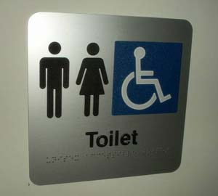
8. Signage
For permanent rooms such as restrooms, signage must have raised letters and braille.
Background and foreground must contrast in color.

Slide 13
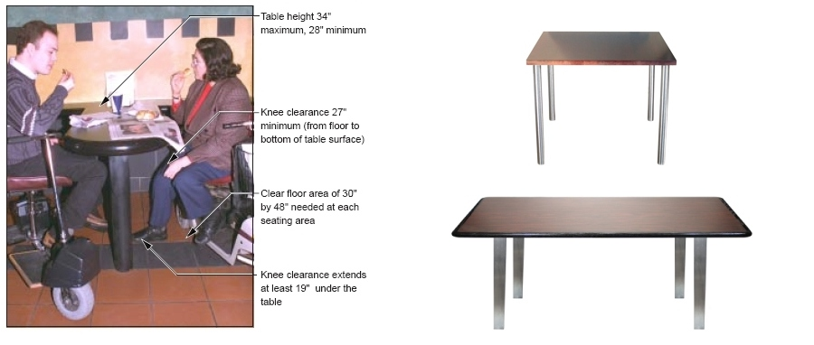
9. Table or Bar Seating
Have accessible seating for people who use a wheelchair.

Slide 14
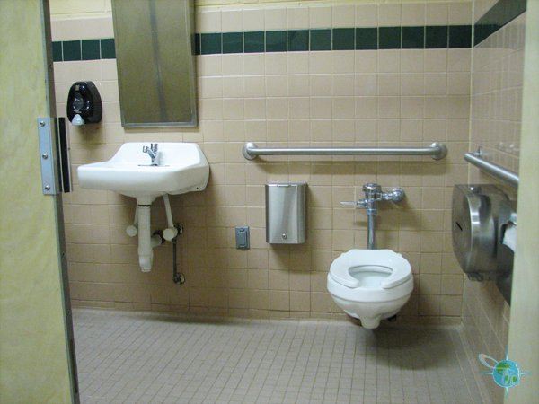
10. Bathrooms
Ensure that waste baskets, etc. do not block clear spaces in accessible stall and sink areas.

Slide 15
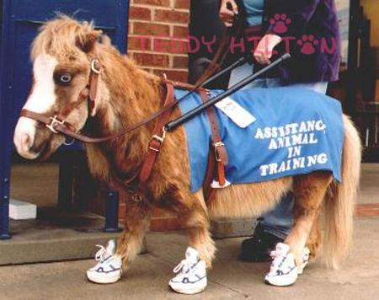
11. Service Animals
If not sure it is a service animal, you can ask a couple of questions:
What tasks is this animal trained to do for you?
Do you need this animal because of a disability?

Slide 16
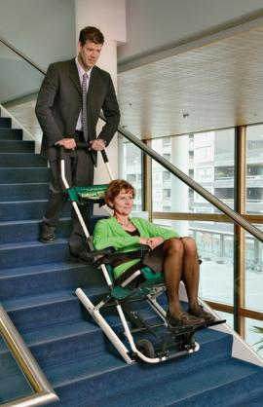
12. Evacuation Plan
Consider how people with disabilities would be evacuated in the event of an emergency, and establish a plan.
Make sure your employees know this plan.

Slide 17
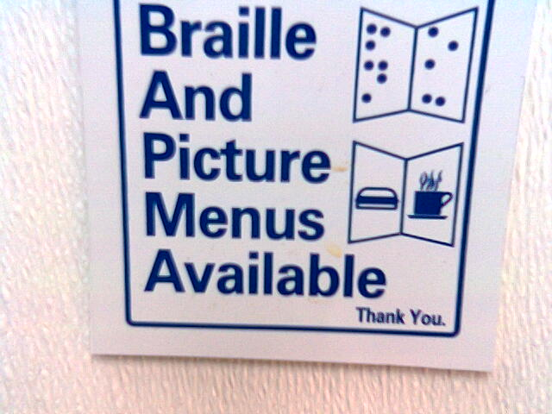
13. Access to Materials
Make menus available online so that (with technology) individuals with blindness and low vision can read them.
Have your staff be ready to read or verbally present the menu to people with blindness.

Slide 18

14. Alternate Service Provision
If your business is not accessible, consider options for service delivery:
Sidewalk service
Home delivery
Personal shopper

Slide 19
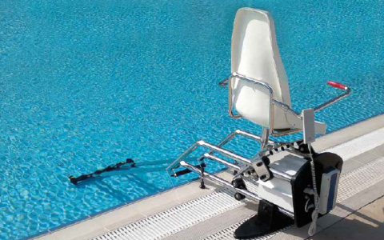
15. Pool Access
Have a pool lift out and ready to be used any time the pool is open.

Slide 20

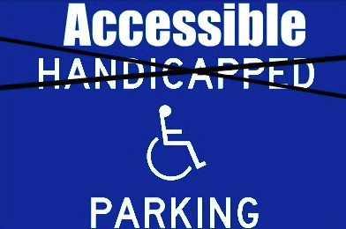
16. People-First Language
Use people-first language when referring to a person with disability.
Avoid using words like “confined to,” “suffers from,” or “handicapped.”
Instead, say “a person who . . .”
“. . . has a disability”
“. . . uses a wheelchair”
“. . . is blind”
Opt for the word “accessible” over “handicapped” on signage.

Slide 21

17. Face-to-Face Communication
If a person with a disability has a companion, speak to the person with a disability, not the companion.*
*Unless directed to do so by the person with a disability

Slide 22
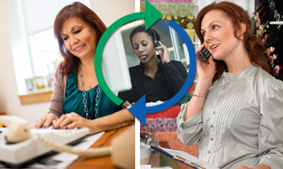
18. Telephone Relay Services
Individuals who are deaf make phone calls using relay services. Please accept these calls, and treat them like any other phone call you receive.

Slide 23

19. Written Information
Structure content in a logical order, using plain English and avoiding long sentences.
Use appropriate font sizes, colors, and contrast on written materials.

Slide 24

20. Accommodations
Be willing to exchange notes to talk with individuals who are deaf or hard of hearing.

Slide 25

21. Patience
Individuals with speech, hearing, and sight disabilities may require extra time. Be patient so that you can understand what is being said, and how to assist.

Slide 26

22. Offering Assistance
Always ask a person with a disability if they need assistance. Never assume they do.

Slide 27
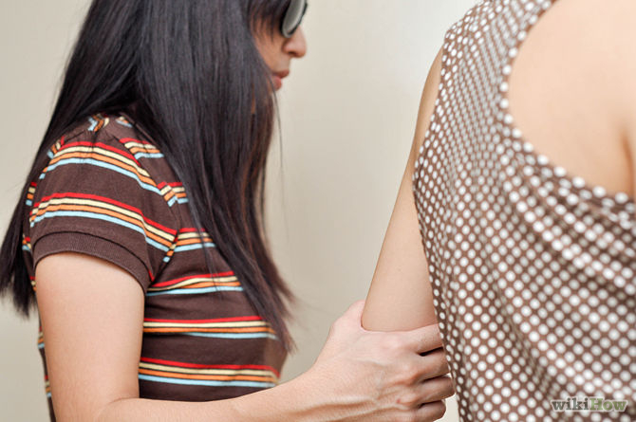
23. Waiting for Acceptance
Offer your arm to a person who is blind who needs to be led to another location, and wait for them to accept the assistance.

Slide 28
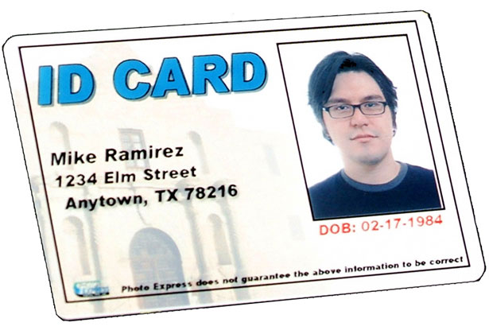
24. Policy Modification
Be willing to modify policy or provide additional assistance. For example, if a policy requires a driver’s license ID, modify it to accept an alternative ID as some people do not drive.

Slide 29
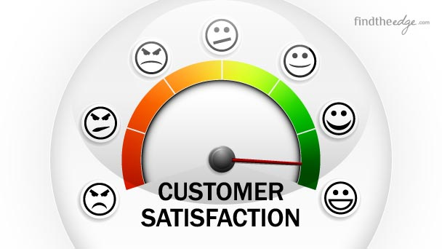
25. Customer Feedback
Comments and input from patrons with disabilities is a great way to learn about your customers, and to make sure they will return to your business time and again.

Slide 30
Reaping the Rewards!
Making your business friendly to people with disabilities will allow you to:
Tap into the population of those with the largest degree of discretionary spending in the market.
Benefit from free marketing through “word of mouth” advertising within the population of people with disabilities and their families/friends.
Augment your business with loyal and dependable employees: qualified people with disabilities.

Slide 31

You Don’t Have to Do It Alone.
There are resources to assist you that are both available and willing to help.
Contacting your local office of Vocational Rehabilitation Services is a great place to start.

Slide 32
Vocational Rehabilitation (VR)
Professionals in counseling, business relations, employment, and disability.
Consultation available for disability-friendly business development and employing people with disabilities, in most cases free of cost.
Resourced in ADA, Section 503 (gov’t contracts), retention of employees who develop disability, hiring people with disability, etc.
Additional resources and information about about an array of VR services to businesses are available at http://www.explorevr.org/toolkits/employer-supports-toolkit

Slide 33


Job-Driven Vocational Rehabilitation Technical Assistance Center
www.explorevr.org
The JD-VRTAC is a national center housed at the Institute for Community Inclusion (ICI) at the University of Massachusetts Boston. The center and its materials are funded by the Rehabilitation Services Administration (RSA) within the US Department of Education under grant #H264A140002.

Slide 34
Job-Driven Center Goals
Improve skills of state VR agency staff, other rehab professionals, and providers of VR services, who are trained to provide “job-driven” VR services and supports to people with disabilities, businesses, and customized training providers.
Four Topic Areas:
Business Engagement
Employer Supports
Labor Market Information
Customized Training Providers
www.explorevr.org

Slide 35






Partnerships
Association of University Centers on Disabilities
www.aucd.org
Council of State Administrators for Vocational
Rehabilitation
www.rehabnetwork.org
Jobs For the Future
www.jff.org
San Diego State University Interwork Institute
http://wintac.org
University of Arkansas CURRENTS www.uacurrents.org
University of Washington Center for Continuing Education in Rehabilitation
www.ccer.org

Slide 36
Acknowledgements
U.S. Census Bureau
U.S. Department of Labor
Survey of Income and Program Participation (SIPP)
pnnonline.org
The New York Times
Kevin A. Fritz, Seyfarth & Shaw
25 Easy Ways to Make Your Business More Accessible to Customers with Disabilities (July 29, 2015)

